Slide 1
Chapter 1
Introduction
Notes:
1.#

Slide 2
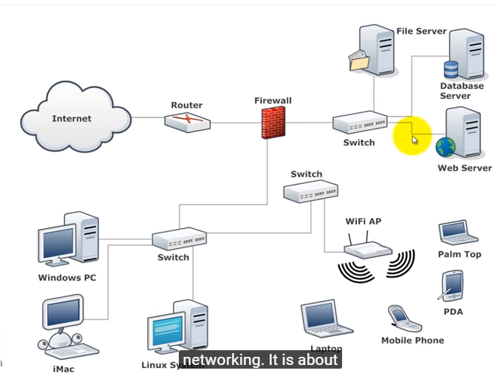

Slide 3
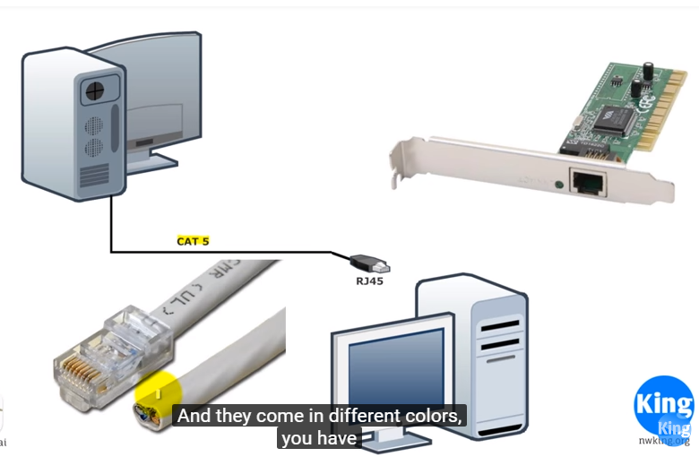

Slide 4
1 DATA COMMUNICATIONS
The term telecommunication means communication at a distance. The word data refers to information presented in whatever form is agreed upon by the parties creating and using the data. Data communications are the exchange of data between two devices via some form of transmission medium such as a wire cable.
Topics discussed in this section:
Components
Data Representation
Data Flow
Notes:
1.#

Slide 5

Figure 1 Five components of data communication
Notes:
1.#

Slide 6

Figure 2 Data flow (simplex, half-duplex, and full-duplex)
Notes:
1.#

Slide 7
2 NETWORKS
A network is a set of devices (often referred to as nodes) connected by communication links. A node can be a computer, printer, or any other device capable of sending and/or receiving data generated by other nodes on the network.
Topics discussed in this section:
Distributed Processing
Network Criteria
Physical Structures
Network Models
Categories of Networks
Interconnection of Networks: Internetwork
Notes:
1.#

Slide 8

Figure 3 Types of connections: point-to-point and multipoint
Notes:
1.#

Slide 9

Figure 4 Categories of topology
Notes:
1.#

Slide 10

Figure 5 A fully connected mesh topology (five devices)
Notes:
1.#

Slide 11

Figure 6 A star topology connecting four stations
Notes:
1.#

Slide 12

Figure 7 A bus topology connecting three stations
Notes:
1.#

Slide 13

Figure 8 A ring topology connecting six stations
Notes:
1.#

Slide 14

Figure 9 A hybrid topology: a star backbone with three bus networks
Notes:
1.#

Slide 15
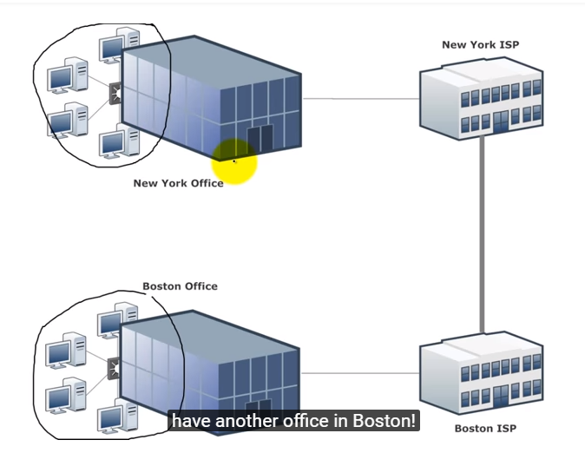

Slide 16

Figure 10 An isolated LAN connecting 12 computers to a hub in a closet
Notes:
1.#

Slide 17

Figure 11 WANs: a switched WAN and a point-to-point WAN
Notes:
1.#

Slide 18

Figure 12 A heterogeneous network made of four WANs and two LANs
Notes:
1.#

Slide 19
3 THE INTERNET
The Internet has revolutionized many aspects of our daily lives. It has affected the way we do business as well as the way we spend our leisure time. The Internet is a communication system that has brought a wealth of information to our fingertips and organized it for our use.
Topics discussed in this section:
A Brief History
The Internet Today (ISPs)
Notes:
1.#

Slide 20

Figure 13 Hierarchical organization of the Internet
Notes:
1.#

Slide 21
4 PROTOCOLS AND STANDARDS
In this section, we define two widely used terms: protocols and standards. First, we define protocol, which is synonymous with rule. Then we discuss standards, which are agreed-upon rules.
Topics discussed in this section:
Protocols
Standards
Standards Organizations
Internet Standards
Notes:
1.#

